Slide 1






@SoyGema
@SoyGema
GEMA PARREÑO PIQUERAS

Slide 2

Computational Graph
Multidimensional Array

Slide 3
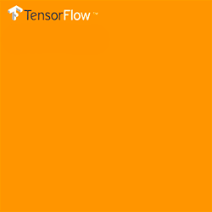
The Main architecture of TensorFlow
TENSOR

Slide 4


ARCHITECTURE TIP
Tensor is a structure in which you can add levels of complexity
From Scalar to time!
TENSOR
Defines structure of the Tensor
RANK
tf.Tensor class
How we write or represent it on TensorFlow
Defines dimensionality
SHAPES
Structure of the kind of data we are going to deal with
TYPES

Slide 5


TENSOR TRANSFORMATIONS
SHAPING
Operations that you can use to determine the shape of a tensor and change the shape of a tensor
tf.reshape(input, name=None)
Reshape a tensor
SLICING & JOINING
Operations to slice or extract parts of a tensor, or join multiple tensors together
Tf.slice(input_, begin, size, name=None)
Extracts a slice of a tensor

Slide 6
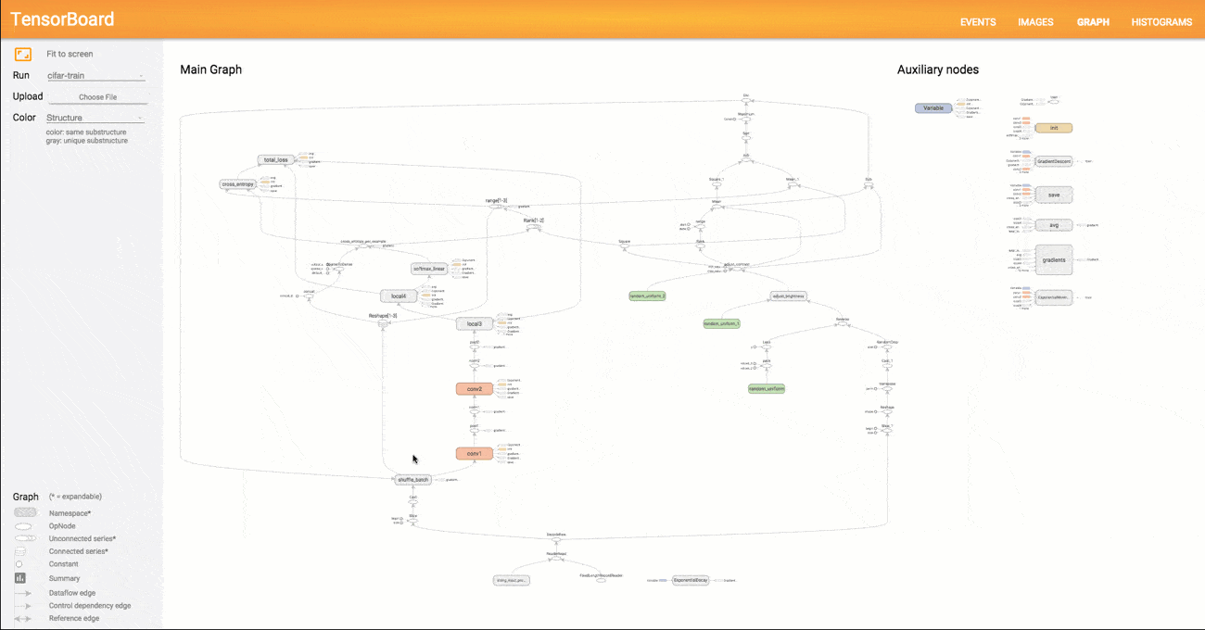
GRAPH
Example of of a data flow graph with multiple nodes (data operations). Notice how the execution of nodes is asynchronous. This allows incredible scalability across many machines

Slide 7
WHAT FOR?

Slide 8
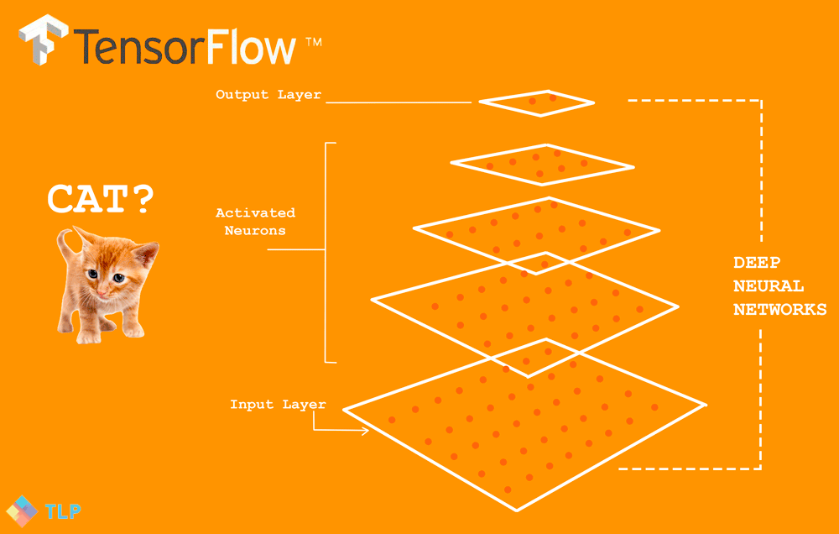
Image Recognition
Classification using Softmax Regressions and Convolutional Neural Networks

Slide 9

Languaje Understanding
Find in SoftMax Regression interesting semantic Relationships

Slide 10
What is TensorFlow used for ?
CLASSIFICATION
PERCEPTION
UNDERSTANDING
DISCOVERING
PREDICTION
CREATION
License Apache
For both Research and Commercial Propouses

Slide 11
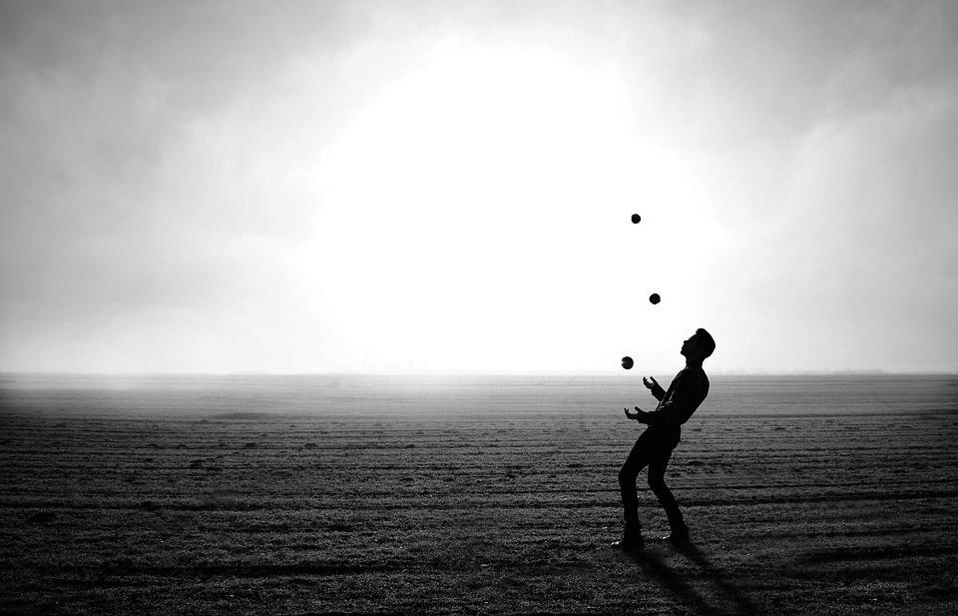
Tips & Tricks for Designing Neural Nets

Slide 12



TIPS & TRICKS
FOR DESIGNING NEURAL NETS
ARCHITECTURE TIP
Seize the data . The selection of training data has already proven to be key in the learning process
ARCHITECTURE TIP
In the Neural Net, how we structure data will define the tensorflow model construction.
ARCHITECTURE TIP
Think about the learning as a multilayered process by design
ARCHITECTURE TIP
In the Neural Net, knowledge hierarchy is key. Think about learning from bottom-top of top-bottom approach

Slide 13






Books
Courses
Tutorials
The BRAIN
Social
https://medium.com/@gema.parreno.piqueras/

Slide 14
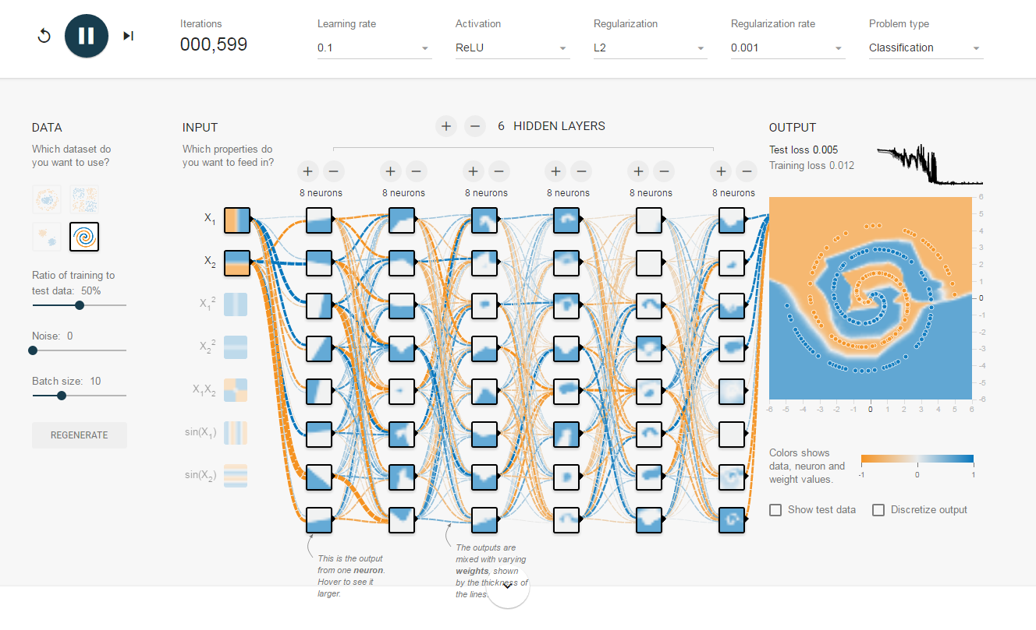
DESIGN THE LEARNING PROCESS in the net
Input / output and activation function
TENSOR FLOW PLAYGROUND

Slide 15
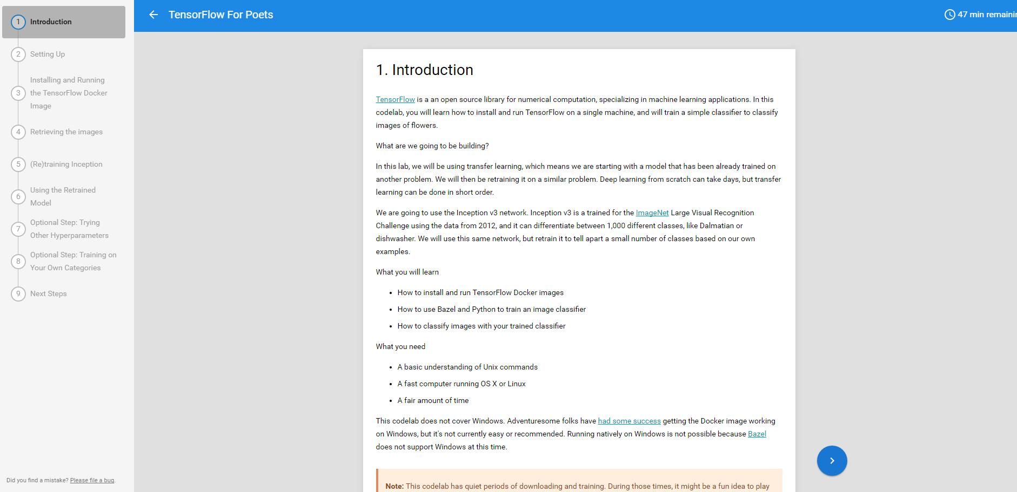
CREATE YOUR OWN CLASSIFIER in the net
Input / output and activation function
TENSORFLOW
FOR POETS

Slide 16

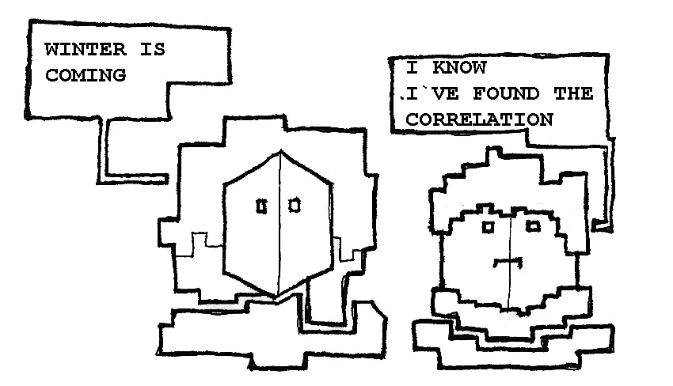
https://soygema.github.io/TensorFlow-GOT/#0

Slide 17

Nasa Apps Challenge 2016

Slide 18

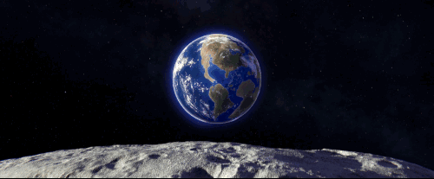

Slide 19



Slide 20
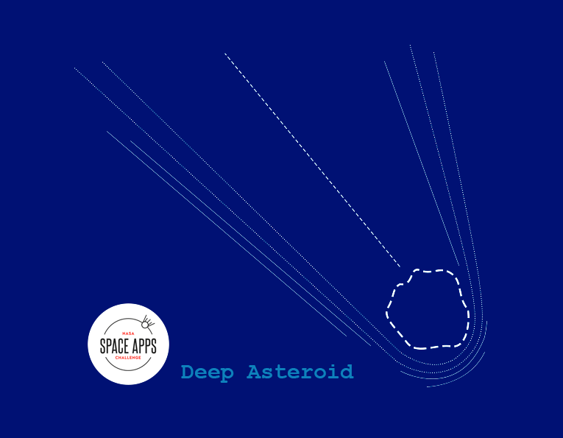

Slide 21
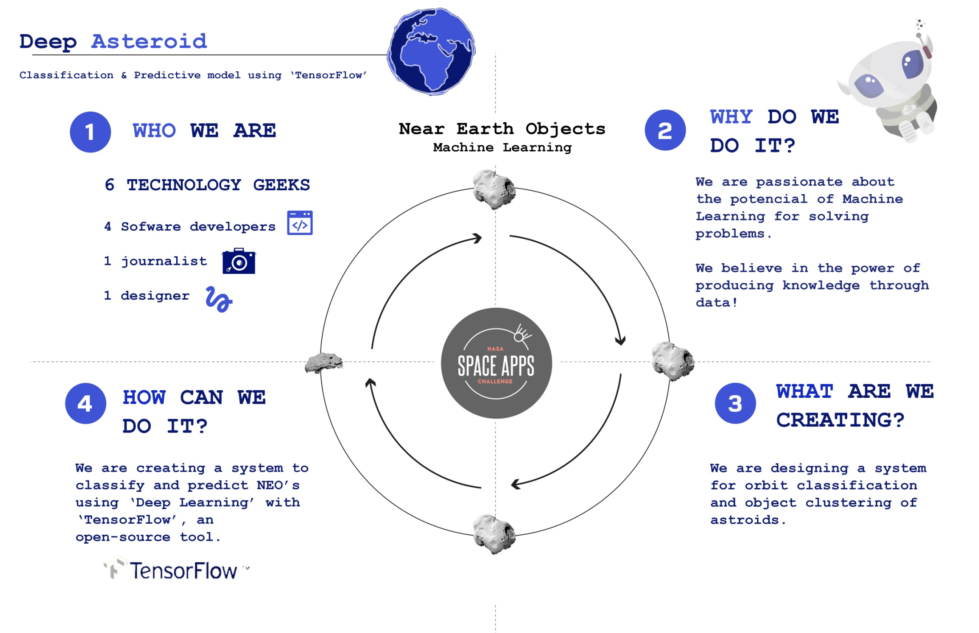

Slide 22
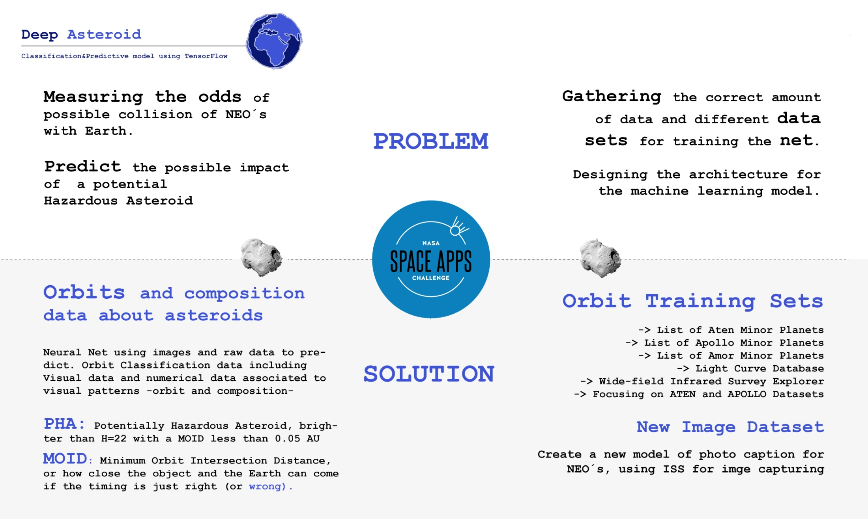

Slide 23
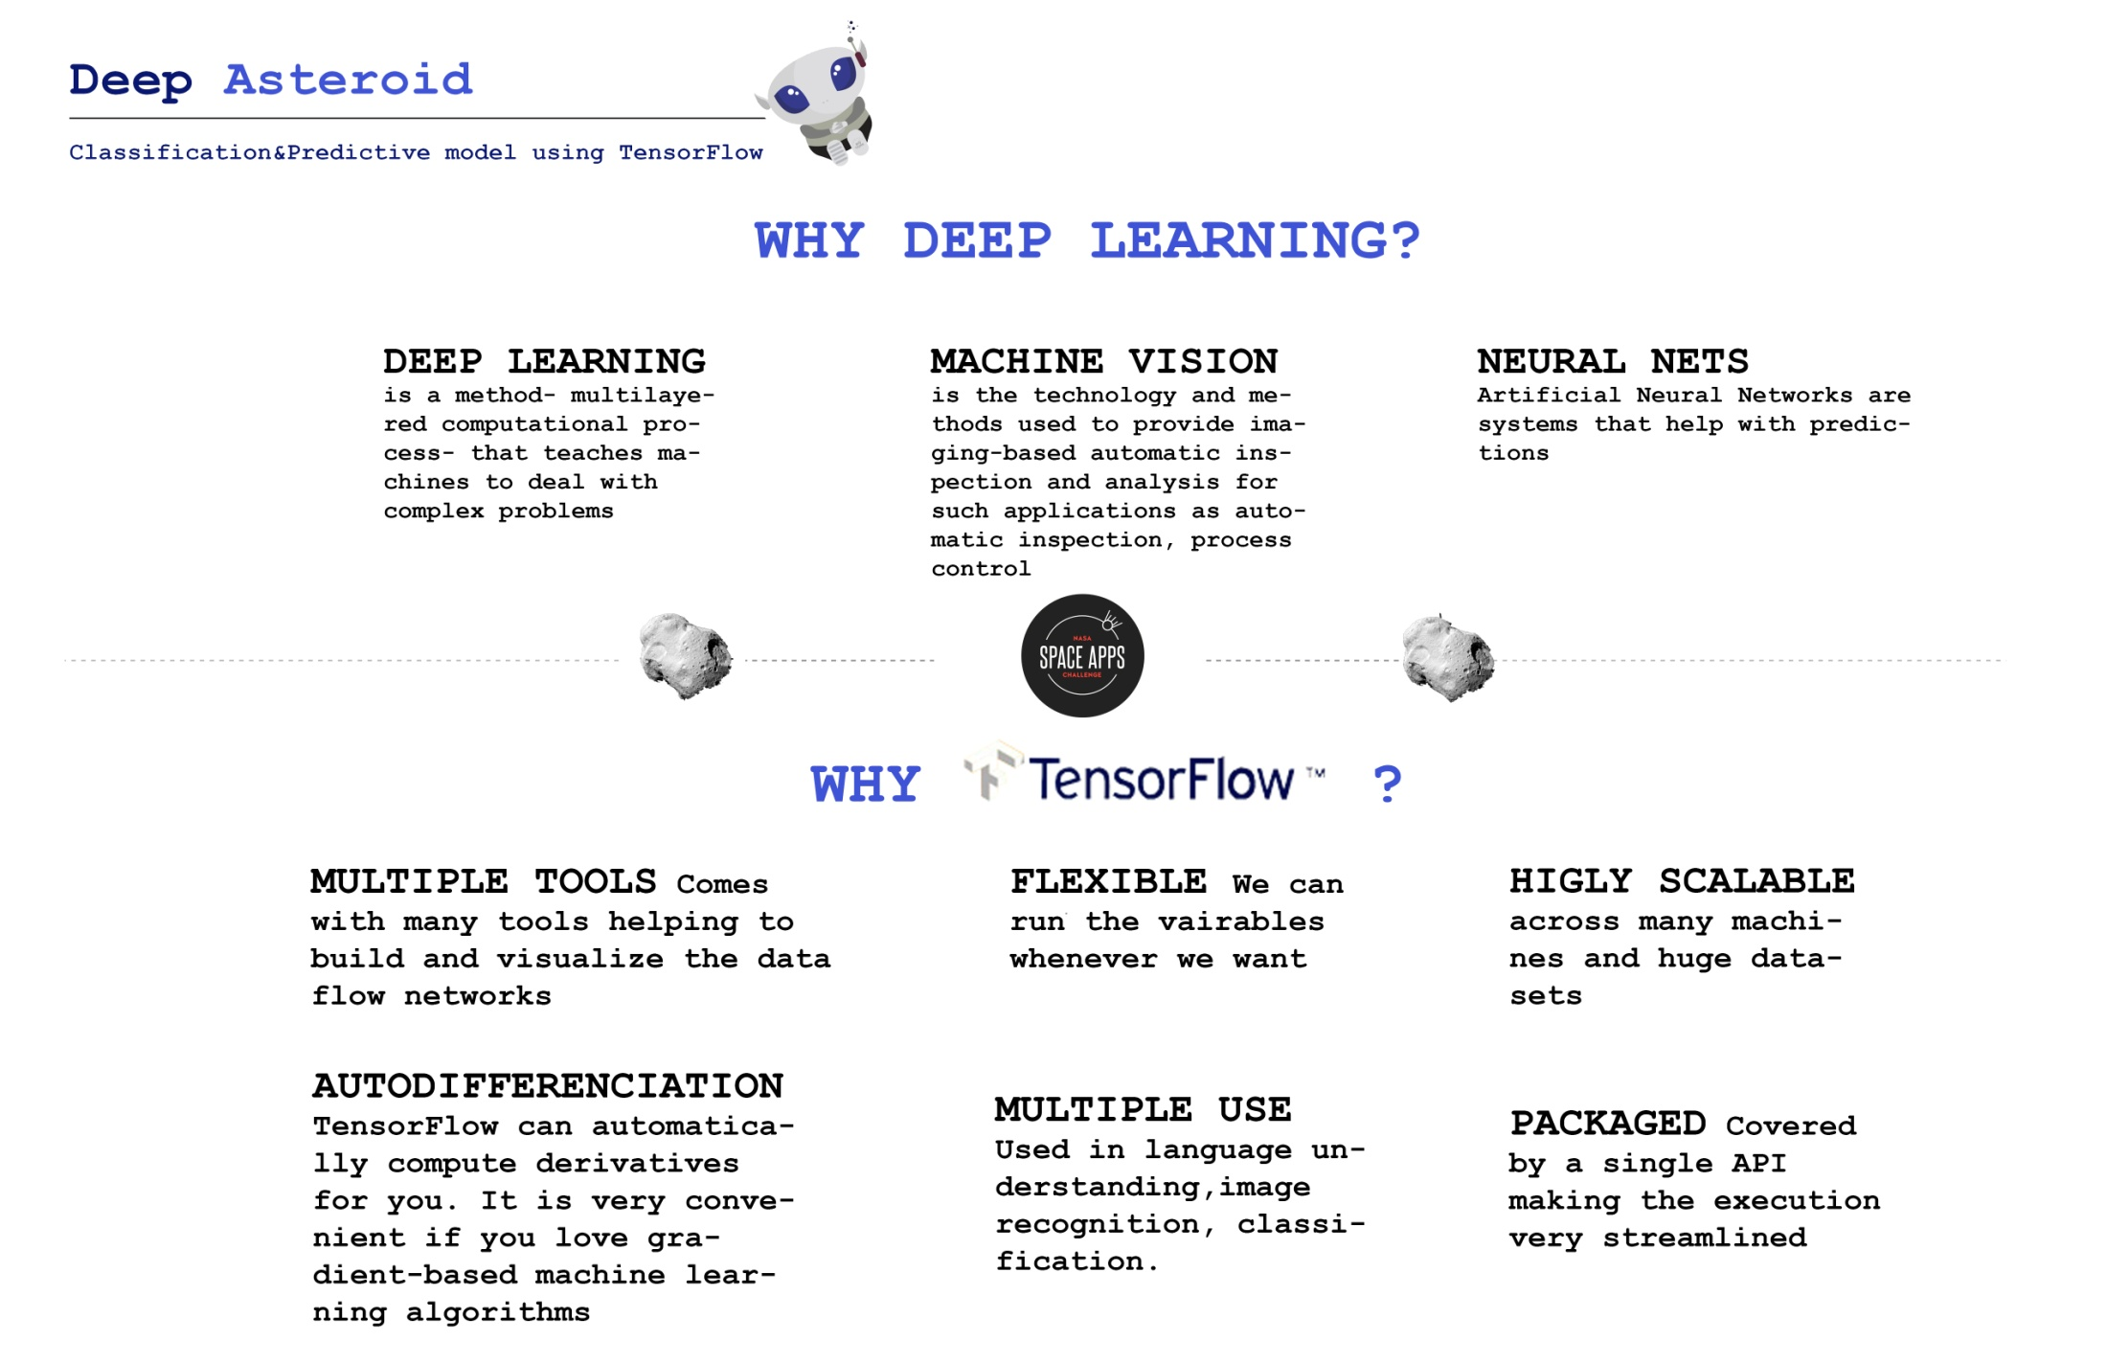

Slide 24
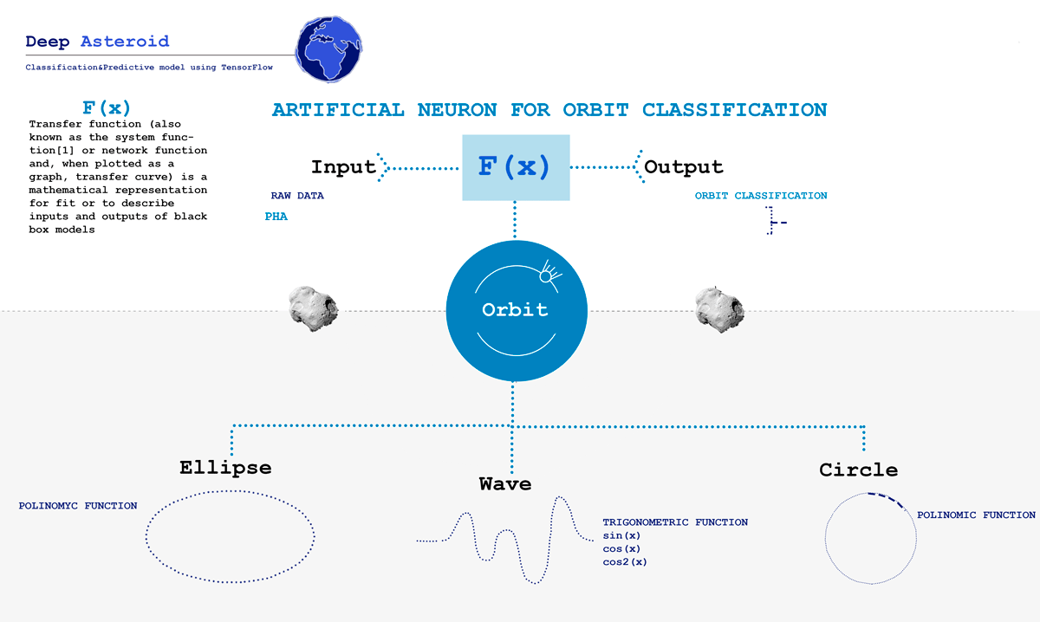

Slide 25
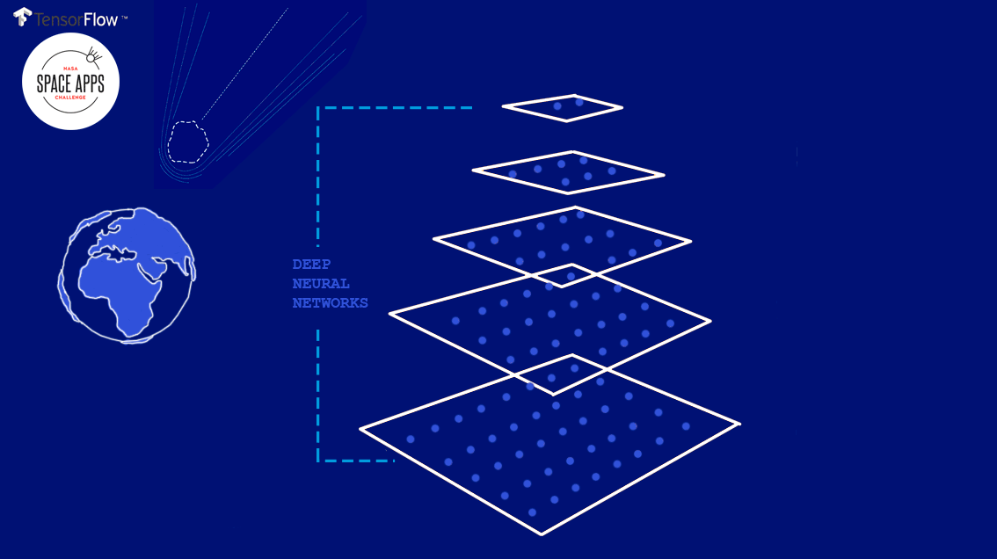

Slide 26




NEURAL NET
Neo´s neural Net design
EXECUTION OF NEO RECOGNIZING PROTOCOL
Execution of the protocol described in “Hazards Due to Comets and Asteroids” Tree decision data pruning process that allows raw data to transform into knowledge
EVALUATION
Execute a Softmax regression with the spectral and physical data about the asteroid, gathering info about the potencial harm the NEO could do.
A
B
C
D
Extract into a CSV the actionable data for training process. Select a balanced dataset for training, including known matched NEO´s.
Feed the neural net with training data. Create a tensor and including a transfer function that matches the known orbit of the NEO and do classification into the 4 main groups.
1st LAYER
DATASETS

Slide 27
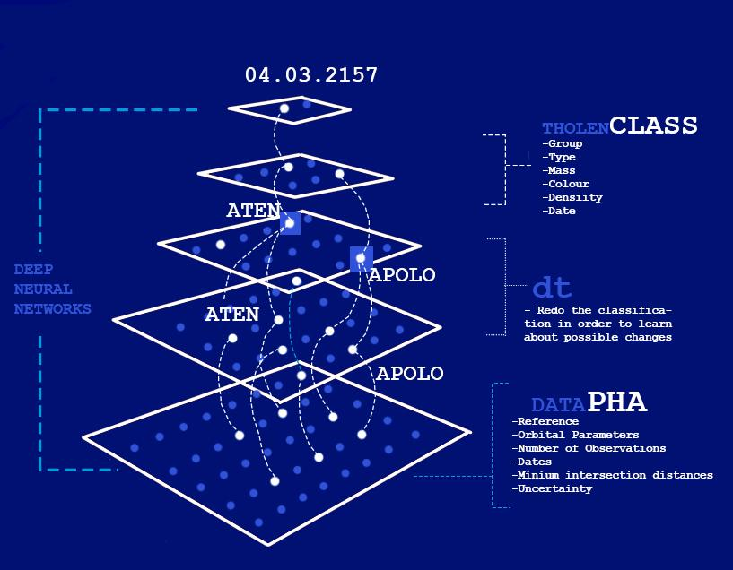
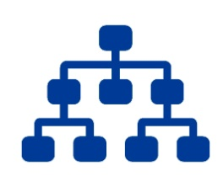
NEURAL NET
Neo´s neural Net design
E
Retrain the Neural Network. Sometimes the observation of NEO´s might drive into changes. The software allow us to prune false positives
2nd LAYER

Slide 28


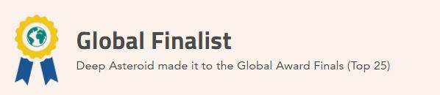

Top 25 project among all projects worldwide
Opportunity to have a high level of abstraction in design, and learn about how the observation of NEO´s can influence into their classification
Variables can be trained about the uncertainty of the change in orbit classification, offering an advantage against other classification approaches
One of the main key concepts about this is about how time can change classification and how we train a neural net to visualize it.

Slide 29

PySC2

Slide 30
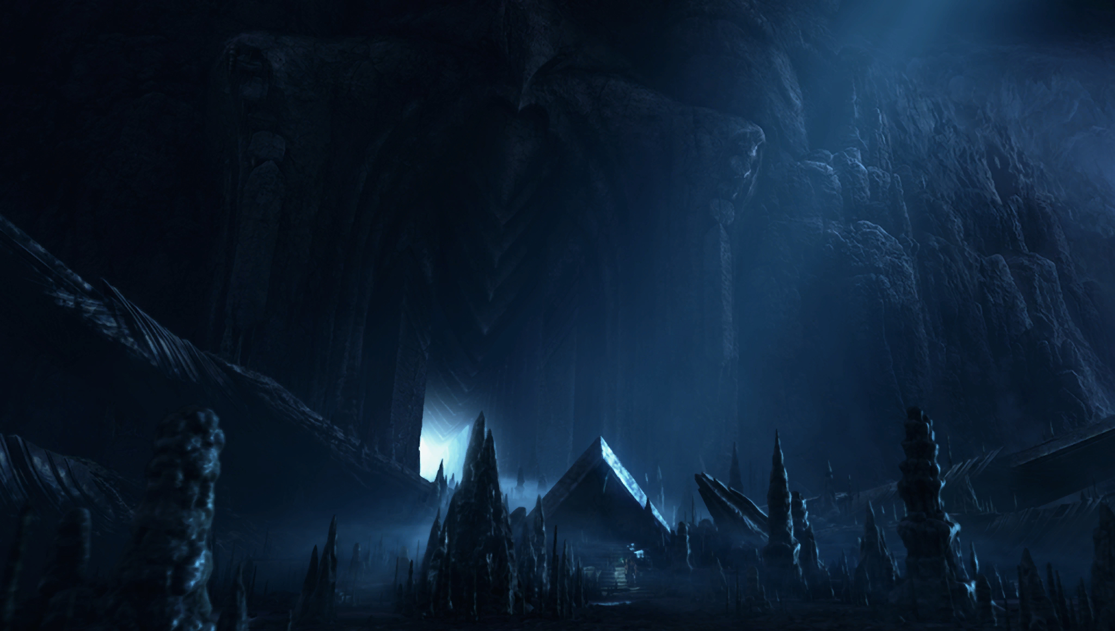
K-MEANS
WIN
Unsupervised
LOSE
PCA
LEAGUE INDEX
AGE
HOURS
PER WEEK
NEURAL
NETWORK
WIN
Supervised
LOSE

Slide 31
WE ARE HIRING !
Thank you!
@SoyGema

